Slide 1
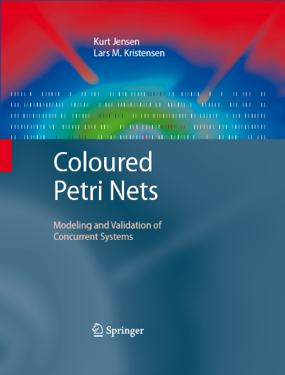
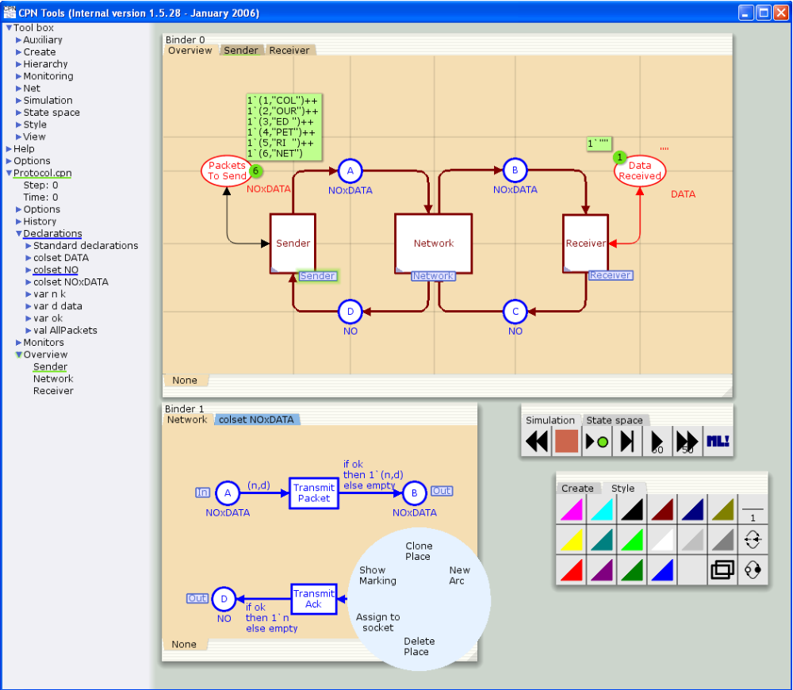
Coloured Petri Nets
Modelling and Validation of Concurrent Systems
Course Introduction
Kurt Jensen
kjensen@cs.au.dk
ADA-220
Coloured Petri Nets
Department of Computer Science
Notes:
English or Danish?
Two items on the agenda:
Practical matters concerning the content and organisation of the course
An introduction to the area of CPNs, modelling and validation.

Slide 2
Coloured Petri Nets 1 (Q3)
The participants will get:
detailed knowledge of Coloured Petri Nets (CPN or CP-nets).
practical experience with modelling and validation of concurrent systems.
Aim
explain constructs and concepts in the CPN modelling language.
define and explain the syntax and semantics of CP-nets.
define and explain properties for characterising the behaviour of concurrent systems.
explain the basic concepts and techniques underlying:
  state space analysis methods.
  simulation-based performance analysis.
apply CP-nets and CPN Tools for modelling and validation of small concurrent systems.
judge the practical application of CP-nets for modelling and validation of concurrent systems.
Learning Outcomes
Coloured Petri Nets
Department of Computer Science
Notes:
Go briefly through the individual items

Slide 3
Coloured Petri Nets 2 (Q4)
The participants will get:
practical experience with modelling and validation of larger concurrent systems.
training to plan and complete projects, and to communicate professional issues.
Aim
construct and structure CPN models of larger concurrent systems.
apply analysis methods for CP-nets for validation of larger concurrent systems.
discuss the application of CP-nets for modelling and validation of larger concurrent systems.
Learning
Outcomes
Coloured Petri Nets
Department of Computer Science

Slide 4
Course material
May be purchased in the book shop at the Department of Mathematical Sciences.
The first two chapters can be down-loaded from the CPN Book web-pages:
www.cs.au.dk/CPnets/cpnbook/
Coloured Petri Nets
Department of Computer Science
Notes:
Hand-out the set of copies.
Stress that any comments are appreciated and encouraged.

Slide 5
Lectures
Q3: Coloured Petri Nets 1.
  Monday 10-12 in Shannon-164 (60-105 min).
  Thursday 10-12 in Shannon-164 (60-105 min).
Q4: Coloured Petri Nets 2.
  Only 1-2 meetings (status presentations).
  Dates and time will be decided later.
It is possible to follow only Coloured Petri Nets 1.
Preparing for lectures:
  You are expected to read the material prior to the lectures.
  I may skip the easier parts in the material and concentrate on the more difficult parts.
Coloured Petri Nets
Department of Computer Science
Notes:
We will not always use the two hours, but in most cases we probably will, so expect the lectures to last for two hours.

Slide 6
CPN Tools
Homepage: www.cs.au.dk/CPNTools
Download:
  username: %
  password: EWR5646
  Version: 2.3.5
MS Windows
Help/questions:
CPNTools-support@cs.au.dk
Coloured Petri Nets
Department of Computer Science
Notes:
Click on the link to the CPN Tools web pages

Slide 7
Mandatory projects
Q3: Coloured Petri Nets 1.
  Project 1: CPN Modelling (2 weeks; parallel to lectures).
  Project 2: State Space Analysis (2 weeks; parallel to lectures).
  Project 3: Performance Analysis (1,5 weeks; parallel to lectures).
  Each documented in a 10-15 pages project report.
Q4: Coloured Petri Nets 2.
  Larger project on CPN modelling and validation (full time).
  You choose the project.
  1-2 progress presentations.
  Documented in a 15-20 pages project report.
Conducted in groups of 2-3 persons.
Start forming the groups now!
Coloured Petri Nets
Department of Computer Science

Slide 8
Exam(s)
Coloured Petri Nets 1:
  Individual oral examination.
  (20 minutes, no advance preparation).
  Based on topics from the textbook material and the three projects.
Everyone is required to take the CPN1 exam.
Coloured Petri Nets 2:
  Individual oral examination.
  (20 minutes, no advance preparation).
  Project and associated report will serve as a basis.
Coloured Petri Nets
Department of Computer Science

Slide 9
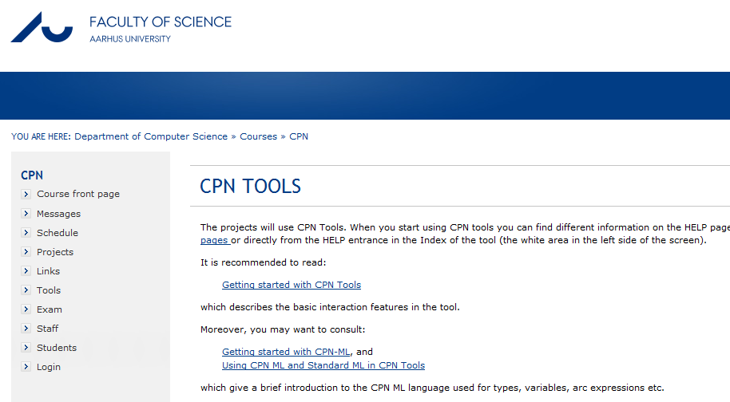
Practical information
www.cs.au.dk/~cpnbook/courses/CPN
OBS!
Coloured Petri Nets
Department of Computer Science
Notes:
Click on the link to the course home page
How many have already accessed the course web page?

Slide 10

Questions
Coloured Petri Nets
Department of Computer Science

